Slide 1
SECURITY SYSTEM
(USING PIEZO SENSORS)
2019ID103513

Slide 2
What is our Project?
Our Project is about Intruder alert system
It works on the principle of pressure sensor
A pressure sensor would be attached near the tiles of every possible inbreak of Intruders.( Ex: Doors, Windows, etc.)

Slide 3
Components Used
Raspberry Pi 3b+
Raspberry Pi cam
Pressure sensors
Resistor, Connecting wires, Power cable
Breadboard( used for demonstrational purposes)
Internet connection through wifi

Slide 4
How does it work?
When someone enters into the area of interest, the pressure sensor connected to the tiles will automatically activate the raspberry pi cam.
Then the pi cam will take a picture of the area of view, and it will mail that to your mail and alert you.

Slide 5
Key Points
Coding all the required commands like pressure detecting, capturing a photo with pi cam and mailing it to your mail.
We have created a mail and included the credentials in our code so that the process is executable all the mails sent by the raspberry pi can be sorted easily in mail.

Slide 6
Where can this be used?
At any place where you want to safeguard.
Ex: 1.Banks,
2.Homes,
3.Government offices,
4.Jails, etc.

Slide 7
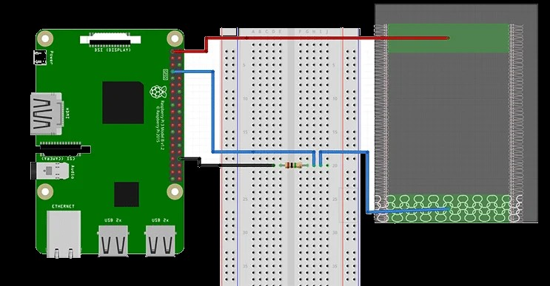
Pressure sensor basic circuit
Resistor and Piezoelectric sensor

Slide 8
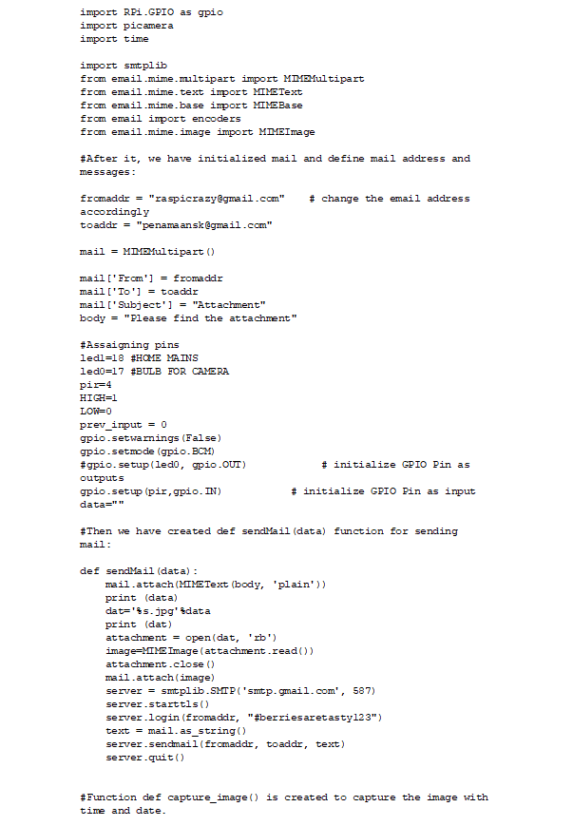
Code

Slide 9
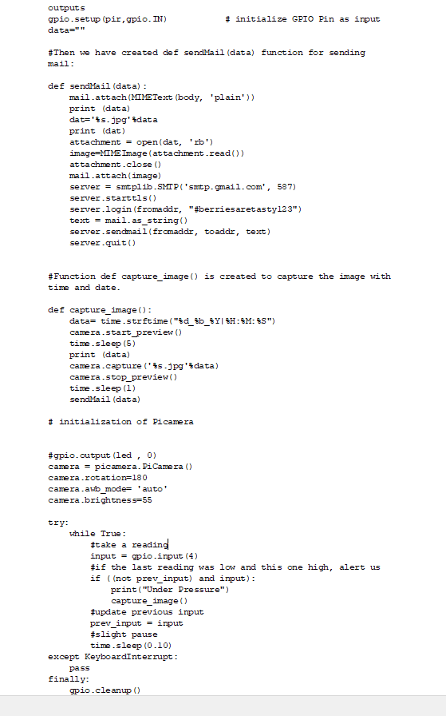

Slide 10

Proof of the tests
Me and the boys looking at pi cam desperately hoping it to work

Slide 11
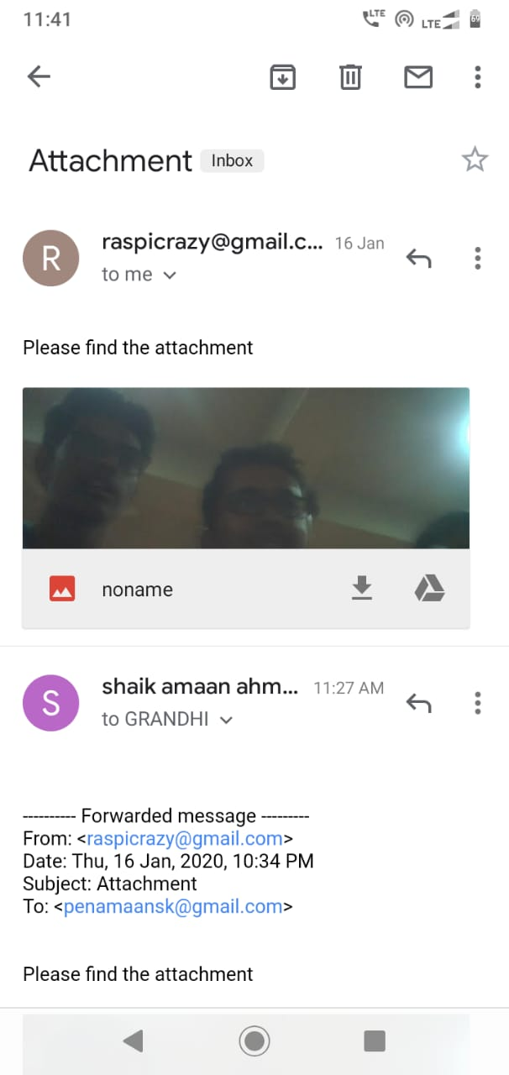
Proof of the tests

Slide 12
Our Team
Sai Sidhardha Grandhi
Pakala Srijith Reddy
Mutta Sohith Kumar Guptha
Chintu Varun Rao
Shaik Amaan Ahmed
Sai Bhargavi Gangula

Slide 13

Thank You
Hope you like our Project

